Slide 1

Efficiency in Hardwired and Microprogrammed Control
Computer Organization and Architecture | Hardwired and Microprogrammed Control
Course: Computer Organization and Architecture | Chapter: Hardwired and Microprogrammed Control | Bachelor of Engineering
DISCOVER · LEARN · EMPOWER
Notes:
Welcome to today's lecture on Efficiency within the context of Control Units. We will focus specifically on how hardwired and microprogrammed approaches differ in their operational speed and resource utilization. This session is designed to help you evaluate which design is superior for specific hardware requirements.

Slide 2
Course Outcomes
SLIDE 2 / 10
Course Outcome
CO | BT LEVEL | DESCRIPTION
CO1 | BT3 | Apply number systems and digital logic to design basic digital circuits
CO2 | BT4 | Analyze register organization and instruction set architecture
CO3 | BT3 | Implement computer arithmetic algorithms and floating-point operations
CO4 | BT5 | Analyze memory hierarchy and input-output organization
CO5 | BT6 | Evaluate control unit design and pipelining performance
Chandigarh University
2 / 10
Notes:
This lecture directly addresses Course Outcome 5, which requires you to evaluate control unit designs. You will learn to compare the performance of different control strategies in the context of pipelining. By the end, you will be able to justify design choices based on efficiency metrics.

Slide 3
Learning Objectives
SLIDE 3 / 10
Learning Outcomes
1
Analyze the speed differences between hardwired and microprogrammed control units.
2
Evaluate the trade-offs between flexibility and execution speed in control design.
3
Calculate the effective instruction cycle time for both control methods.
4
Synthesize a control strategy based on specific application efficiency requirements.
5
Critique the impact of microcode length on overall system throughput.
Chandigarh University
3 / 10
Notes:
By the end of this session, you will be able to analyze speed differences and evaluate trade-offs. We will calculate effective instruction cycle × to understand the quantitative impact of design choices. Finally, you will synthesize a control strategy that balances flexibility with raw execution speed.

Slide 4
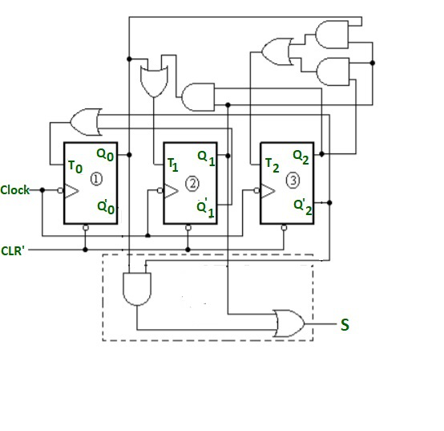
Lecture
SLIDE 4 / 10
Hardwired Control Efficiency
1
Hardwired control uses dedicated logic gates to generate control signals directly.
2
It offers the highest execution speed due to minimal signal propagation delay.
3
Efficiency is measured by the number of clock cycles per instruction.
4
Design complexity increases significantly as the instruction set grows larger.
5
It is less flexible because changing instructions requires physical hardware changes.
Control Signals Generation using Counter - GeeksforGeeks
Chandigarh University
4 / 10
Notes:
Hardwired control is like a dedicated race car engine where every part is optimized for speed. It generates signals using fixed logic gates, resulting in the fastest possible execution. However, this efficiency comes at the cost of flexibility; adding a new instruction requires redesigning the hardware.

Slide 5
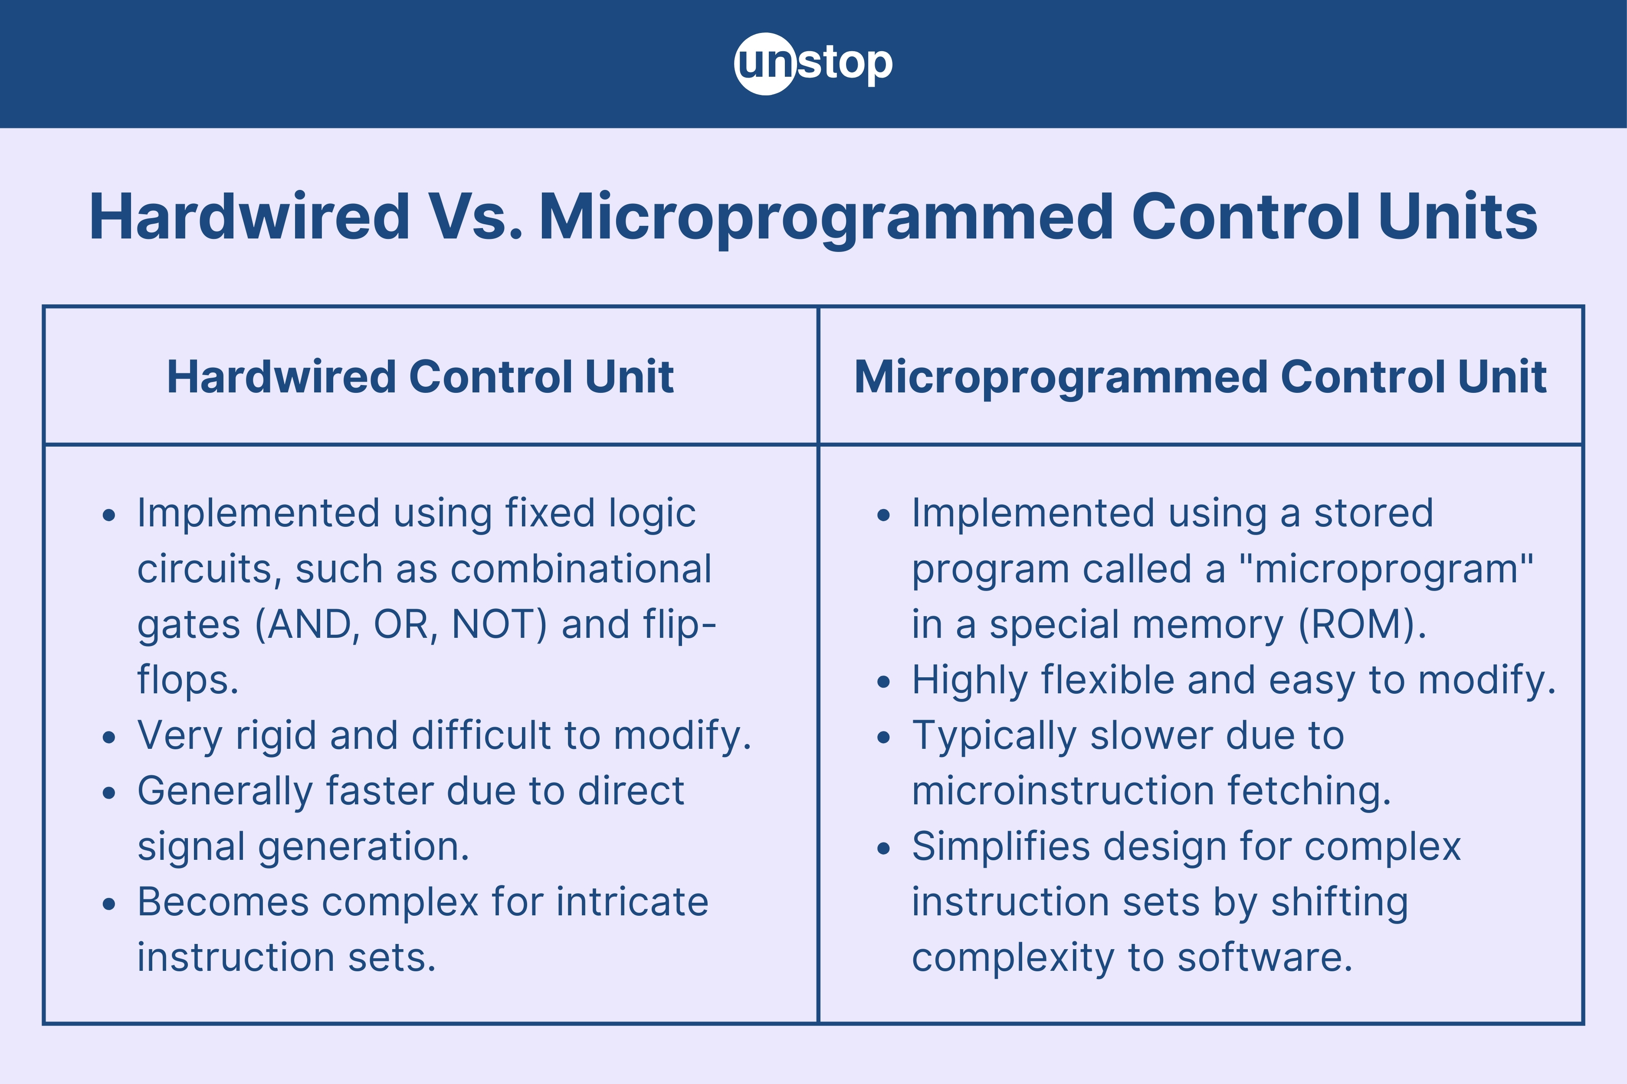
Lecture
SLIDE 5 / 10
Microprogrammed Control Efficiency
1
Microprogrammed control stores control signals as microinstructions in a control memory.
2
It offers high flexibility as new instructions can be added via software.
3
Execution speed is slower due to the time required to fetch microinstructions.
4
Efficiency is measured by the depth of the microprogram and memory access time.
5
It simplifies the design of complex instruction sets compared to hardwired logic.
Key Differences Between Hardwired & Microprogrammed Control Unit (source: d8it4huxumps7.cloudfront.net)
Chandigarh University
5 / 10
Notes:
Think of microprogrammed control as a programmable computer within a computer. It stores control signals in memory, making it highly flexible for complex instruction sets. The trade-off is that fetching each microinstruction takes time, making it generally slower than hardwired logic.

Slide 6
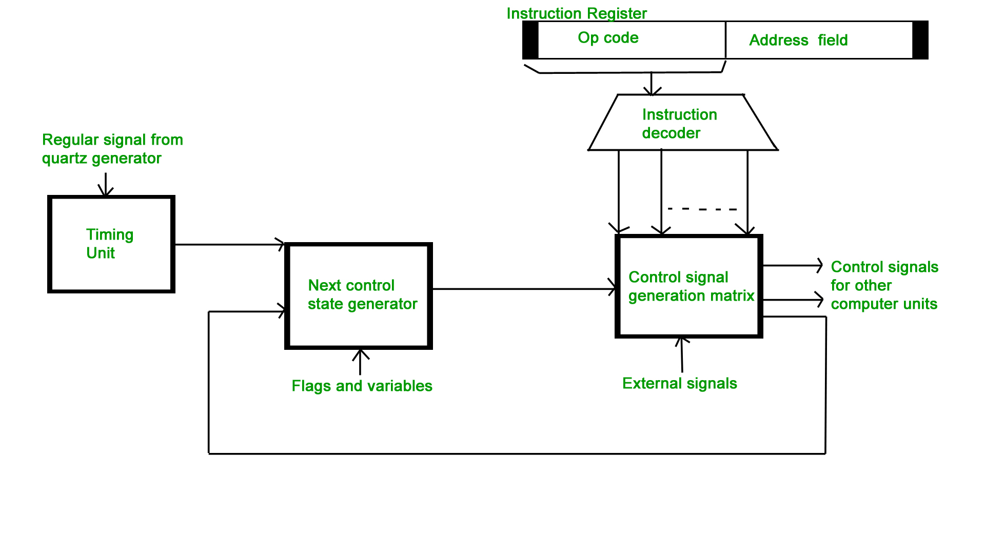
Lecture
SLIDE 6 / 10
Speed Comparison Metrics
1
Hardwired control typically executes instructions in 1 to 2 clock cycles.
2
Microprogrammed control often requires 3 to 5 clock cycles per instruction.
3
The speed ratio is approximately 2:1 in favor of hardwired designs.
4
Microprogrammed overhead includes fetching the microinstruction from control memory.
5
Hardwired speed is limited only by the propagation delay of logic gates.
Hardwired and Micro-programmed Control Unit - GeeksforGeeks (source: www.geeksforgeeks.org)
Chandigarh University
6 / 10
Notes:
When comparing speed, hardwired control is significantly faster, often executing instructions in just one or two cycles. Microprogrammed control typically takes three to five cycles due to memory fetch overhead. This creates a speed ratio of roughly 2:1, favoring the hardwired approach for high-performance needs.

Slide 7
Lecture
SLIDE 7 / 10
Flexibility vs. Speed Trade-off
1
Hardwired control sacrifices flexibility for maximum execution speed and efficiency.
2
Microprogrammed control sacrifices speed for ease of modification and debugging.
3
Complex instruction sets are more efficiently implemented using microprogramming.
4
Simple instruction sets are more efficiently implemented using hardwired logic.
5
The choice depends on whether the priority is speed or adaptability.
Chandigarh University
7 / 10
Notes:
The core trade-off is between speed and flexibility. Hardwired control sacrifices adaptability to achieve maximum speed, making it ideal for simple, fixed instruction sets. Conversely, microprogrammed control sacrifices speed to allow for easy updates and complex instruction handling.

Slide 8
Lecture
SLIDE 8 / 10
Numerical Efficiency Example
GOVERNING EQUATION
Hardwired execution time = 2 ns × 2 = 4 ns per instruction
1
Assume a hardwired unit takes 2 ns per cycle and 2 cycles per instruction.
2
Assume a microprogrammed unit takes 2 ns per cycle and 4 cycles per instruction.
3
Microprogrammed execution time = 2 ns × 4 = 8 ns per instruction.
4
Hardwired is 2 × faster (8 ns / 4 ns) for this specific case.
Key Differences Between Hardwired & Microprogrammed Control Unit (source: d8it4huxumps7.cloudfront.net)
Chandigarh University
8 / 10
Notes:
Let's look at a concrete example. If both units have a 2 nanosecond cycle time, the hardwired unit takes 2 cycles for 4 nanoseconds total. The microprogrammed unit takes 4 cycles for 8 nanoseconds total. This clearly shows the hardwired unit is twice as fast in this scenario.

Slide 9
Lecture
SLIDE 9 / 10
Key Takeaways
1
Hardwired control is faster but less flexible than microprogrammed control.
2
Microprogrammed control is slower but allows easier modification of instruction sets.
3
Efficiency depends on the specific requirements of speed versus flexibility.
4
Hardwired designs are preferred for high-speed, fixed instruction sets.
5
Microprogrammed designs are preferred for complex, evolving instruction sets.
Key Differences Between Hardwired & Microprogrammed Control Unit (source: d8it4huxumps7.cloudfront.net)
Chandigarh University
9 / 10
Notes:
To summarize, hardwired control offers superior speed but lacks flexibility, while microprogrammed control offers adaptability at the cost of speed. The choice of design depends entirely on whether your priority is raw performance or the ability to modify the instruction set. Always evaluate the specific application requirements before selecting a control method.

Slide 10
Lecture
SLIDE 10 / 10
References
COMPUTER ORGANIZATION AND DESIGN
The Hardware/Software Interface — David A. Patterson, John L. Hennessy
COMPUTER ARCHITECTURE
A Quantitative Approach — John L. Hennessy, David A. Patterson
• Computer Organization and Architecture — William Stallings
• Computer System Architecture — M. Morris Mano & Rajib Mall
• Computer Organization — Carl Hamacher, Zvonko Vranesic, Safwat Zaky
Chandigarh University
10 / 10
Notes:
These five textbooks provide the foundational knowledge for understanding control unit design and efficiency. I encourage you to read the chapters on control units in Stallings and Mano for deeper insights. The works by Patterson and Hennessy offer excellent quantitative approaches to evaluating these designs.

